Slide 1
FAIR USE NOTICE
The material used in this presentation i.e., pictures/graphs/text, etc. is solely intended for educational/teaching purpose, offered free of cost to the students for use under special circumstances of Online Education due to COVID-19 Lockdown situation and may include copyrighted material - the use of which may not have been specifically authorised by Copyright Owners. Its application constitutes Fair Use of any such copyrighted material as provided in globally accepted law of many countries. The contents of presentations are intended only for the attendees of the class being conducted by the presenter.

Slide 2
CLOUD COMPUTING
Notes:
Reference: Distributed Computing Principles and Applications by M.L.Liu
2

Slide 3
CONTENT
An Archetypal Distributed Object Architecture
Distributed Object Systems
RPC
RMI
THE JAVA RMI ARCHITECTURE
Processes
The API for Java RMI

Slide 4
An Archetypal Distributed Object Architecture
Premise behind this paradigm is to minimize the programming differences between remote and local method calls.
Whereas in actuality there are differences because remote method invocations required IPC between independent processes
Issues such as data marshaling and event synchronization need to be encapsulated in the architecture.
Notes:
An original model or type after which other similar things are patterned; a prototype
4

Slide 5
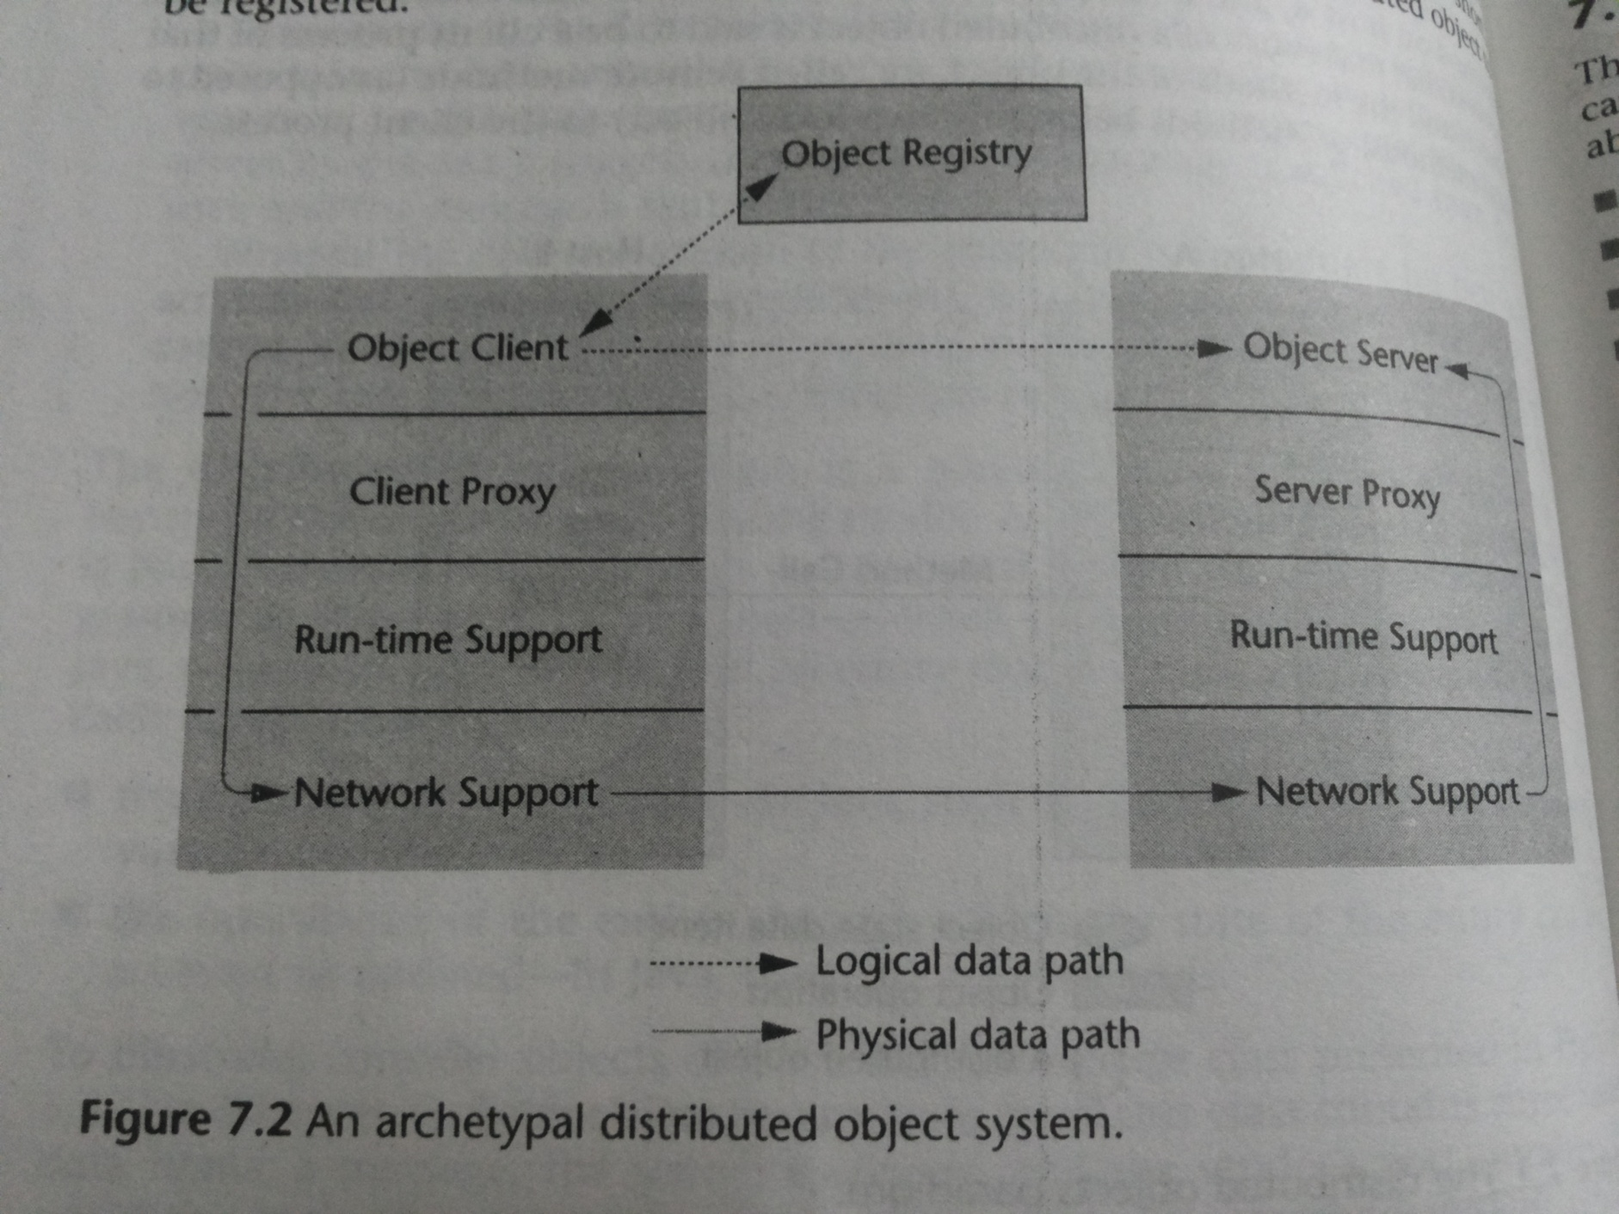

Slide 6
A distributed object is provided or exported by a process called object server.
A facility called object registry must be present.
To access a distributed object, a process called object client looks up in the registry for a reference to the object.
Logically, the remote call is made directly by the object client but in reality, the call is handled by a client proxy.
Client proxy interacts with software on client host to provide run time support for the distributed object system.
This run time support is responsible for IPC including the marshaling of data.
Notes:
Reference is handle for an object. Representation through which object can be located.
Proxy here refers to an intermediary between software components.
6

Slide 7
Similar architecture on the server side.
Run time support handles the receiving of messages and unmarshaling of data, and forwards the call to server proxy.
Server proxy interfaces with distributed object to invoke the method call locally passing the unmarshaled data for the arguments.
The outcome of the execution including the return value is forwarded by server proxy to client proxy via the two layers below.

Slide 8
Distributed Object Systems
A large number of toolkits based on this paradigm are available. Among the most well known of such toolkits are:
Java Remote Method Invocation (RMI),
Systems based on the Common Object Request Broker Architecture (CORBA),
The Distributed Component Object Model (DCOM), and
Toolkits and APIs that support the Simple Object Access Protocol (SOAP).

Slide 9
Remote Procedure Calls (RPC)
RMI has its origin in RPC.
The conventional procedure call can be termed as local procedure call.
In RPC model, a procedure call is made by one process to another possibly residing in a remote system with data passed as arguments.
On calling the remote procedure, actions are executed and a return value if any is sent from the callee to the caller
To hide the details of RPC, a tool called rpcgen is used to transform remote procedure call directed to a stub or proxy.
Two prevalent APIs: Open Network Computing RPC, Open Group DCE RPC.
Notes:
In procedural languages, a procedure or a function is a control structure that provides the abstraction for an action.
9

Slide 10
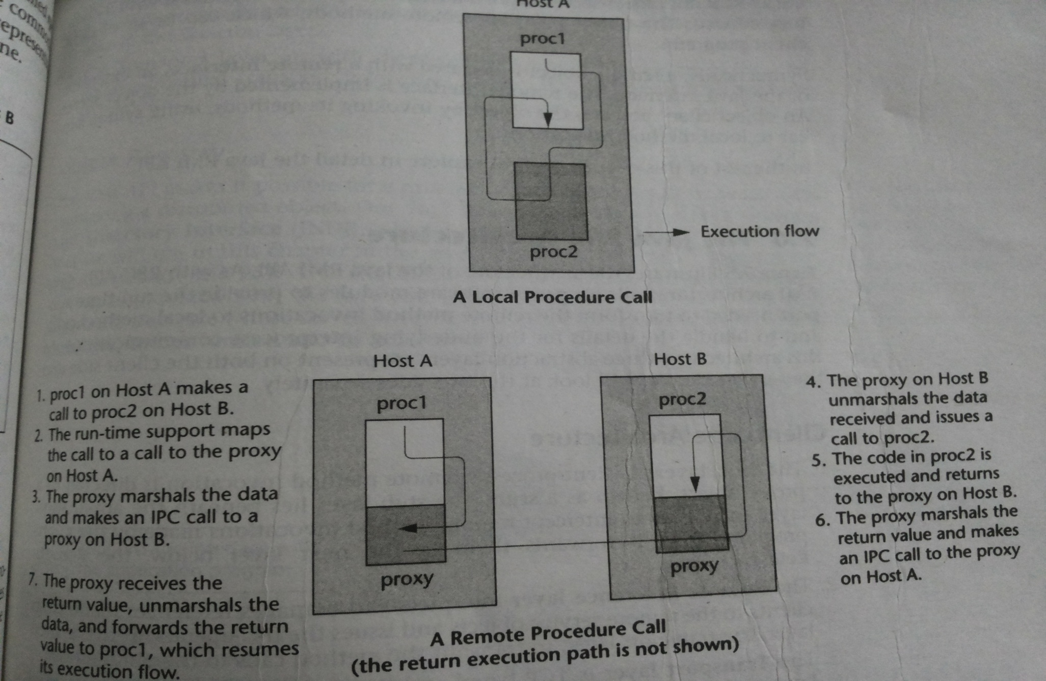
Local Procedure Call v/s RPC

Slide 11
Remote Method Invocation
RMI is OO implementation of RPC model.
It is an API for java programs only.
An object server exports a remote object and registers it with a directory service. The object provides remote methods, which can be invoked in client programs.
Using RMI, an object client accesses methods on the remote object using syntax similar to local method invocations

Slide 12
Consider the following program organization:
method call
SomeClass
AnotherClass
returned object
computer 1
computer 2
RMI is one technology that makes this possible.

Slide 13
13
RMI and other technologies
CORBA (Common Object Request Broker Architecture) has long been king
CORBA supports object transmission between virtually any languages
Objects have to be described in IDL (Interface Definition Language), which looks a lot like C++ data definitions
CORBA is complex and flaky
Microsoft supported CORBA, then COM, now .NET
RMI is purely Java-specific
Java to Java communications only
As a result, RMI is much simpler than CORBA

Slide 14
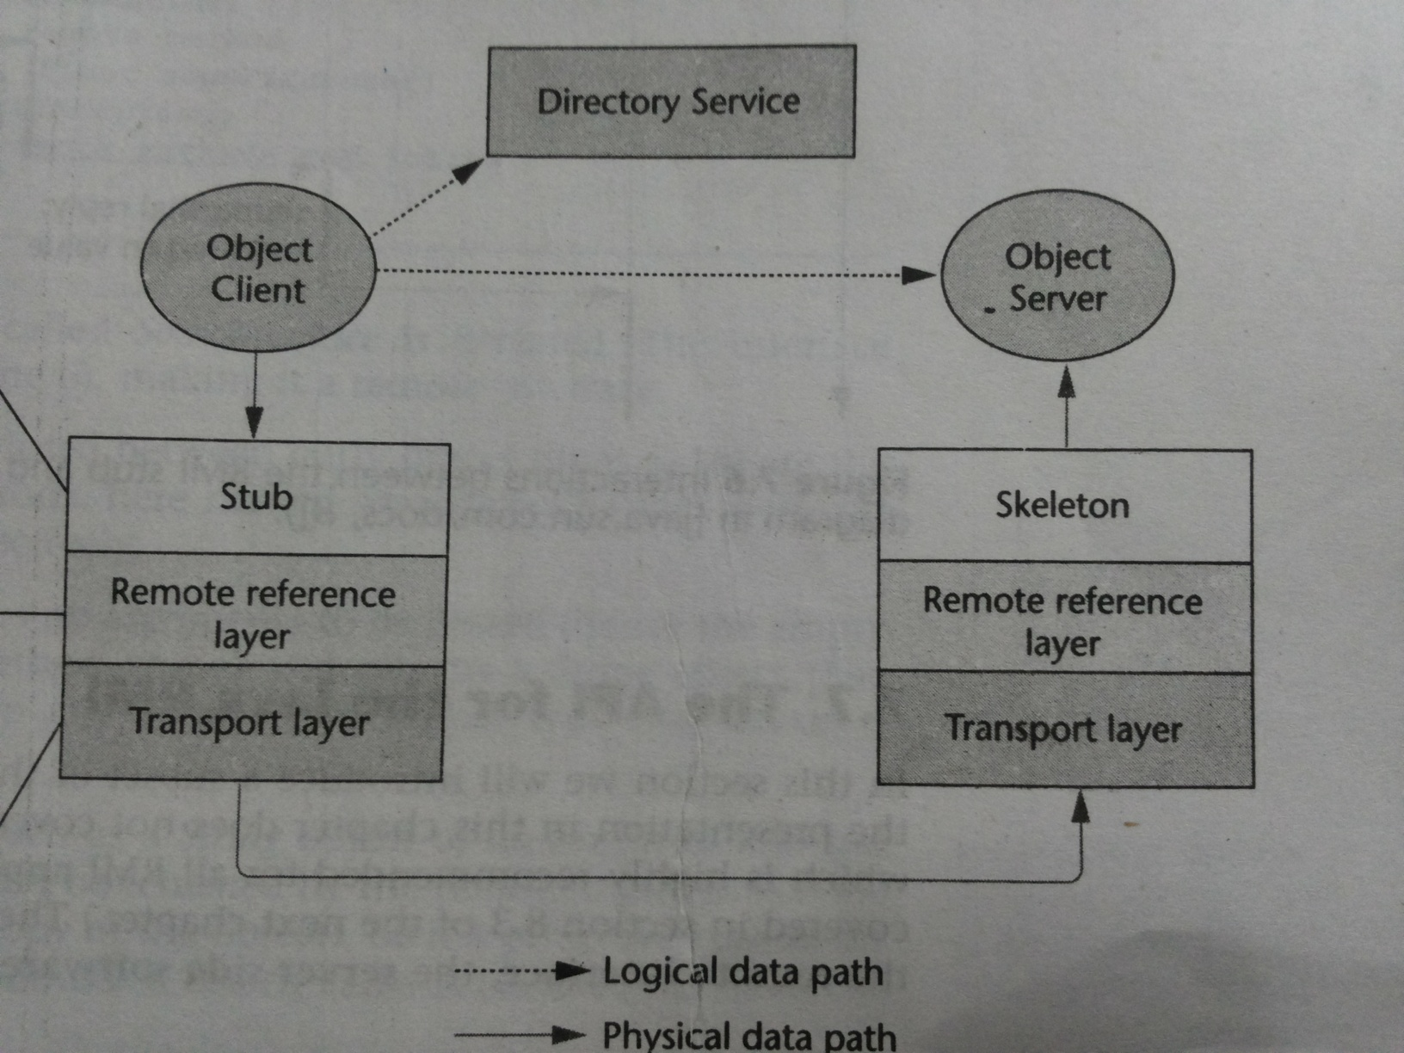
THE JAVA RMI ARCHITECTURE

Slide 15
Client Side Architecture
The Stub Layer: A client’s request for remote method invocation is directed to a proxy called stub. It intercepts the requests and forwards them to the next layer below.
Remote Reference Layer: It interprets messages and manages references and issues IPC operations to the next layer.
Transport Layer: It is TCP based and therefore connection oriented. It carries out the inter process communication transmitting the data representing the method call to the remote host.

Slide 16
Server Side Architecture
The Skeleton Layer: It interacts with the stub layer on the client side. Skeleton reads parameters for the method call from the link, makes the call, accepts the return value and writes it back to the stub. (Skeletons are outdated since Java 1.2. )
Remote Reference Layer: It manages and transforms the remote reference originating from the client to local references that are understandable to the skeleton layer.
Transport Layer: Its same as with the client side architecture.

Slide 17
17
What is needed for RMI
Java makes RMI (Remote Method Invocation) fairly easy, but there are some extra steps
To send a message to a remote “server object,”
The “client object” has to find the object
Do this by looking it up in a registry
The client object then has to marshal the parameters (prepare them for transmission)
Java requires Serializable parameters
The server object has to unmarshal its parameters, do its computation, and marshal its response
The client object has to unmarshal the response

Slide 18
18
MARSHALLING AND UNMARSHALLING
Whenever a client invokes a method that accepts parameters on a remote object, the parameters are bundled into a message before being sent over the network. These parameters may be of primitive type or objects. In case of primitive type, the parameters are put together and a header is attached to it. In case the parameters are objects, then they are serialized. This process is known as marshalling.
At the server side, the packed parameters are unbundled and then the required method is invoked. This process is known as unmarshalling.

Slide 19
19
Terminology
A remote object is an object on another computer
The client object is the object making the request (sending a message to the other object)
The server object is the object receiving the request
As usual, “client” and “server” can easily trade roles (each can make requests of the other)
The rmiregistry is a special server that looks up objects by name(URL)
Hopefully, the name is unique!
rmic is a special compiler for creating stub (client) and skeleton (server) classes

Slide 20
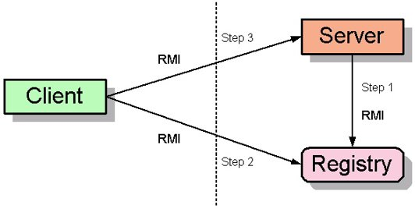
20
Processes
For RMI, you need to be running three processes
The Client
The Server
The Object Registry, rmiregistry, which is like a DNS service for objects
You also need TCP/IP active

Slide 21
21
Interfaces
Interfaces define behavior
Classes define implementation
Therefore,
In order to use a remote object, the client must know its behavior (interface), but does not need to know its implementation (class)
In order to provide an object, the server must know both its interface (behavior) and its class (implementation)
In short,
The interface must be available to both client and server
The class should only be on the server

Slide 22
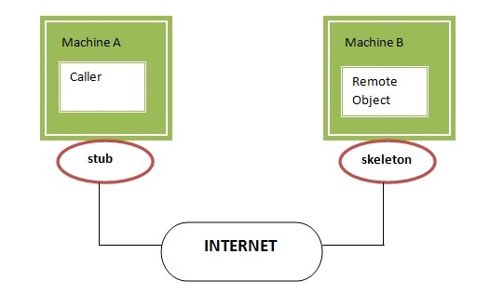
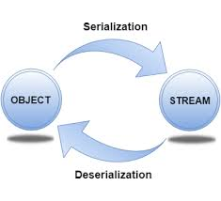
22
Classes
A Remote class is one whose instances can be accessed remotely
On the computer where it is defined, instances of this class can be accessed just like any other object
On other computers, the remote object can be accessed via object handles
A Serializable class is one whose instances can be marshaled (turned into a linear sequence of bits) or whose instances can be copied from one address space to another
Serializable objects can be transmitted from one computer to another
It probably isn’t a good idea for an object to be both remote and serializable as it makes the design difficult to understand.

Slide 23
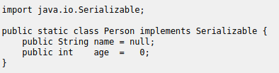
23
Conditions for serializability
If an object is to be serialized:
The class must be declared as public
The class must implement Serializable
All fields of the class must be serializable: either primitive types or serializable objects

Slide 24
TO USE THE API FOR JAVA RMI
Define (or locate) the remote interface in agreement with the server.
Write your server; You need to write two parts for the server:
An implementation class for the remote objects
and a main method to register the remote object in the rmiregistry
(Optional) Run rmic implementation class to generate the stubs.
Write the client
You want to write a client to use an RMI service.
Locate the object on rmiregistry and call its methods

Slide 25
25
Remote interfaces and class
A Remote class has two parts:
The interface (used by both client and server):
Must be public
Must extend the interface java.rmi.Remote
Every method in the interface must declare that it throws java.rmi.RemoteException (other exceptions may also be thrown)
The class itself (used only by the server):
Must implement a Remote interface
Should extend java.rmi.server.UnicastRemoteObject
May have locally accessible methods that are not in its Remote interface

Slide 26
26
Remote vs. Serializable
A Remote object lives on another computer (such as the Server)
You can send messages to a Remote object and get responses back from the object
All you need to know about the Remote object is its interface
Remote objects don’t pose much of a security issue
You can transmit a copy of a Serializable object between computers
The receiving object needs to know how the object is implemented; it needs the class as well as the interface
There is a way to transmit the class definition.
Using a serializable object in a remote method invocation is straightforward. One simply passes the object using a parameter or as the return value.
If the Client and Server programs are on different machines, then class definitions of Serializable classes may have to be downloaded from one machine to the other. Such a download could violate system security.
Accepting classes does pose a security issue

Slide 27
27
Security
The RMISecurityManager defines a security policy that allows the downloading of Serializable classes from another machine. Your client program should use a more conservative security manager than the default
For example, RMI will download a Serializable class from another machine only if there is a security manager and the security manager permits the downloading of the class from that machine. The RMISecurityManager class defines an example of a security manager that normally permits such downloads. We can code it as:
System.setSecurityManager(new RMISecurityManager());
Most discussions of RMI assume you should do this on both the client and the server
Unless your server also acts as a client, it isn’t really necessary on the server
Notes:
One of the central and unique features of RMI is its ability to download the definition of an object's class if the class is not defined in the receiver's Java virtual machine. All of the types and behavior of an object, previously available only in a single Java virtual machine, can be transmitted to another, possibly remote, Java virtual machine. RMI passes objects by their actual classes, so the behavior of the objects is not changed when they are sent to another Java virtual machine.
27

Slide 28
28
The server class
The class that defines the server object should extend UnicastRemoteObject
Objects of such a class exist in the address space of the server and can be invoked remotely.
While there are other ways to define a Remote class, this is the simplest way to ensure that objects of a class can be used as remote objects.
If you must extend some other class, you can use exportObject() instead
The server class needs to register its server object:
String url = "rmi://" + host + ":" + port + "/" + objectName;
The default port is 1099
Naming.rebind(url, object);
Every remotely available method must throw a RemoteException (because connections can fail)
Every remotely available method should be synchronized

Slide 29
29
Hello world server: interface
import java.rmi.*; public interface HelloInterface extends Remote { public String say() throws RemoteException; }

Slide 30
30
Hello world server: class
import java.rmi.*; import java.rmi.server.*; public class Hello extends UnicastRemoteObject implements HelloInterface { private String message; // Strings are serializable
public Hello (String msg) throws RemoteException { message = msg; }
public String say() throws RemoteException { return message; } }

Slide 31
31
Registering the hello world server
class HelloServer { public static void main (String[] args) { try { Naming.rebind("rmi://localhost/HelloServer", new Hello("Hello, world!")); System.out.println("Hello Server is ready."); } catch (Exception e) { System.out.println("Hello Server failed: " + e); } } }

Slide 32
32
The hello world client program
class HelloClient { public static void main (String[] args) { HelloInterface hello; String name = "rmi://localhost/HelloServer"; try { hello = (HelloInterface)Naming.lookup(name); System.out.println(hello.say()); } catch (Exception e) { System.out.println("HelloClient exception: " + e); } } }

Slide 33
33
Rmic (No Longer Necessary)
The class that implements the remote object should be compiled as usual
Then, it should be compiled with rmic:
rmic Hello
This will generate files Hello_Stub.class (dynamically created now) and Hello_Skel.class
These classes do the actual communication
The “Stub” class must be copied to the client area
The “Skel” was needed in SDK 1.1 but is no longer necessary

Slide 34
34
Trying RMI
In three different terminal windows:
Run the registry program:
rmiregistry
Run the server program:
java HelloServer
Run the client program:
java HelloClient
If all goes well, you should get the “Hello, World!” message

Slide 35
35
Summary - RMI
Start the registry server, rmiregistry
Start the object server
The object server registers an object, with a name, with the registry server
Start the client
The client looks up the object in the registry server
The client makes a request
The request actually goes to the Stub class
The Stub classes on client and server talk to each other
The client’s Stub class returns the result

Slide 36
36
RMI Callback
The client acts as a client needing the services of an RMI server. It also provides and registers a remote object for a service that it provides to the server (thus acting as a server itself).
The server has a remote service registered that the client can invoke. In addition, as part of its response to the client, when its service is invoked, the server can ask the client to invoke the client’s remote service and send a response back to the server.
Notes:
36

Slide 37
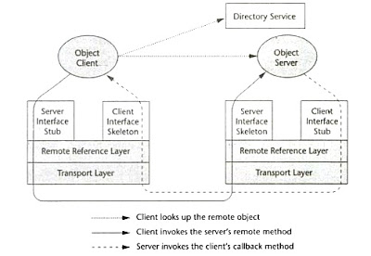
RMI Callback
Notes:
37

Slide 38
38
RMI Callback -sequence of communications
Server node registers a remote object for its service.
Client node registers a remote object for its service.
Client contacts registry and asks for server’s remote object’ s reference.
Registry responds to client with the reference
Client sends a message to server invoking the service.
Server prepares the message packets with required data from the execution of the service (if any).
In addition as part of the response to the client, the server contacts the registry and ask’s for a reference to the remote object that represents the client’ s service.
The registry responds with the reference to the server.
The server asks the client for the invocation of its service.
Therefore both the data from the execution of the server’s service and the request for the client to execute its service for the server are sent out as part of the response to step 5.
Notes:
38

Slide 39
7. The client receives the data that it requested and also executes its service to satisfy the server’s request.
8. The client sends any data to the server in its response to the server’s request.

Slide 40
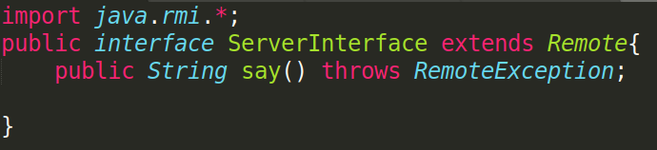
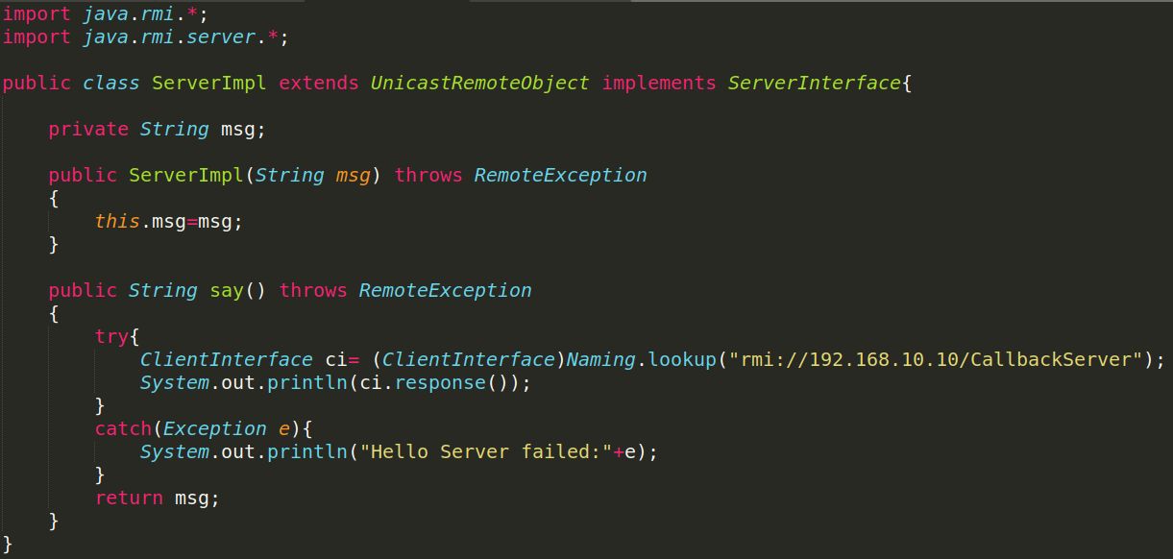
40
RMI Callback – Example (Server End)
Notes:
42

Slide 41
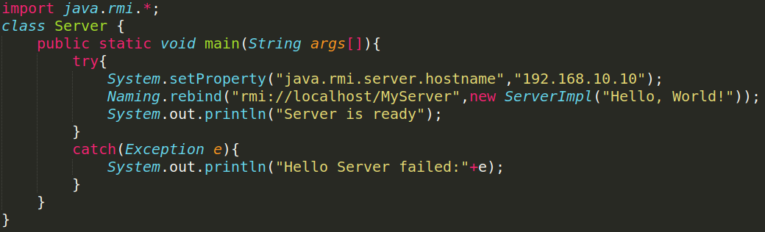
41
RMI Callback – Example (Server End)
Notes:
40

Slide 42
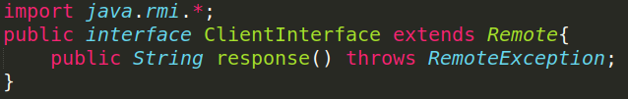
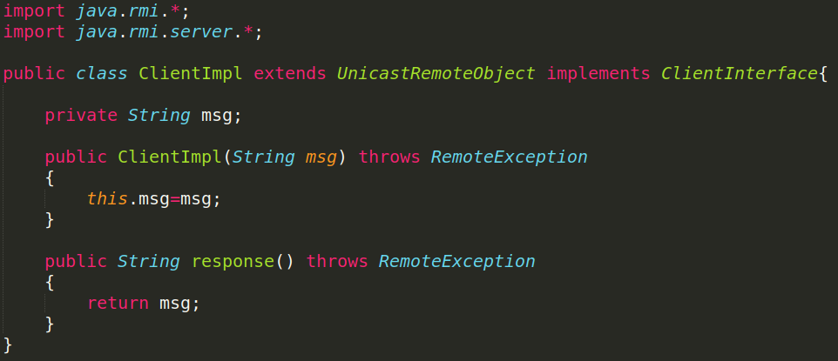
42
RMI Callback – Example (Client End)
Notes:
41

Slide 43
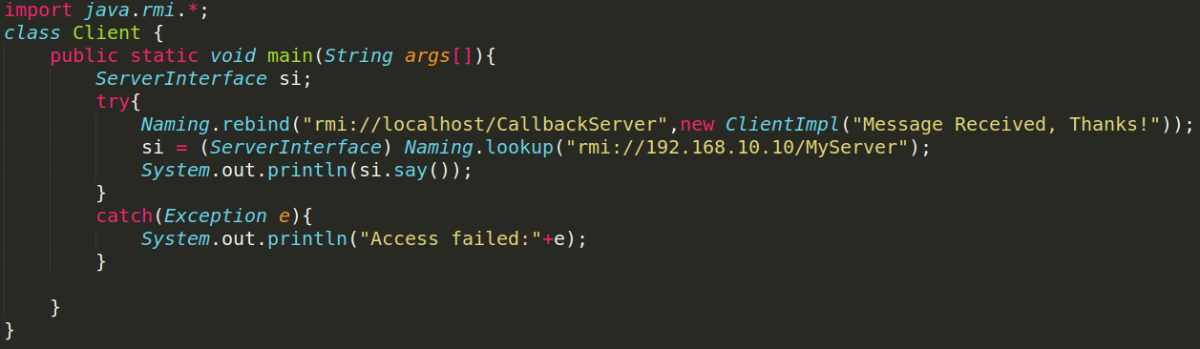
43
RMI Callback – Example (Client End)
Notes:
43

Slide 44
44
RMI Callback
Notice that the distribution of the files are shown below:
Client
Server
Client application program
Client’ s interface: ClientInterface
Server’s interface: ServerInterface
Client's Implementation class: ClientImpl
Client’s stub (Automatic)
Server ‘s stub (Automatic)
Server application program
Server’ s interface: ServerInterface
Client’s interface: ClientInterface
Server's Implementation class: ServerImpl
Server’s stub (Automatic)
Client ‘s stub (Automatic)
Notes:
44

